Slide 1

MID PROJECT REDESIGN PROJECT
GROUP - 28
SAI SRIRAM UPPADA

Slide 2

DATASET OF PLACEMENTS DATA OF FULL CLASS

Slide 3
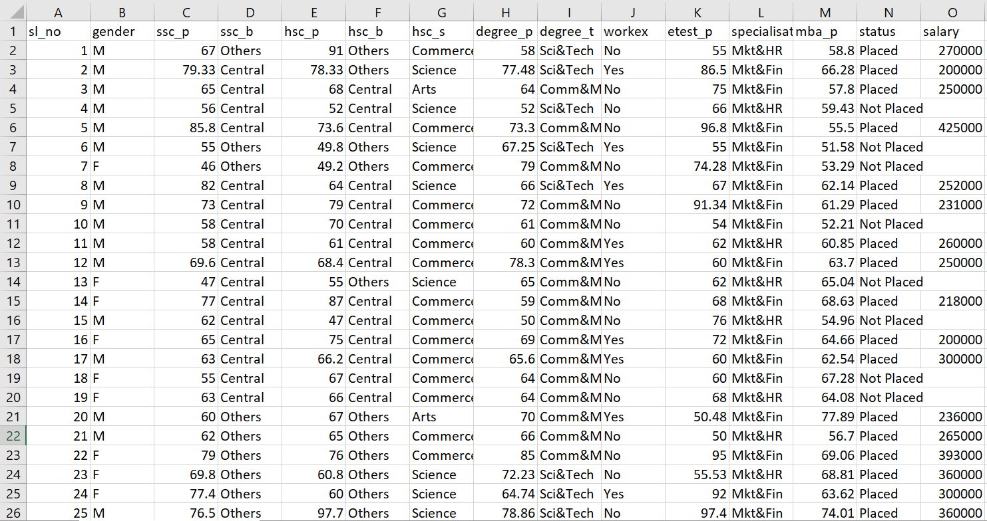
PLACEMENTS DATA OF FULL CLASS DATASET -- OF THE ORIGINAL GRAPH

Slide 4
ORIGINAL AND REDESIGNED REPRESENTATIONS

Slide 5
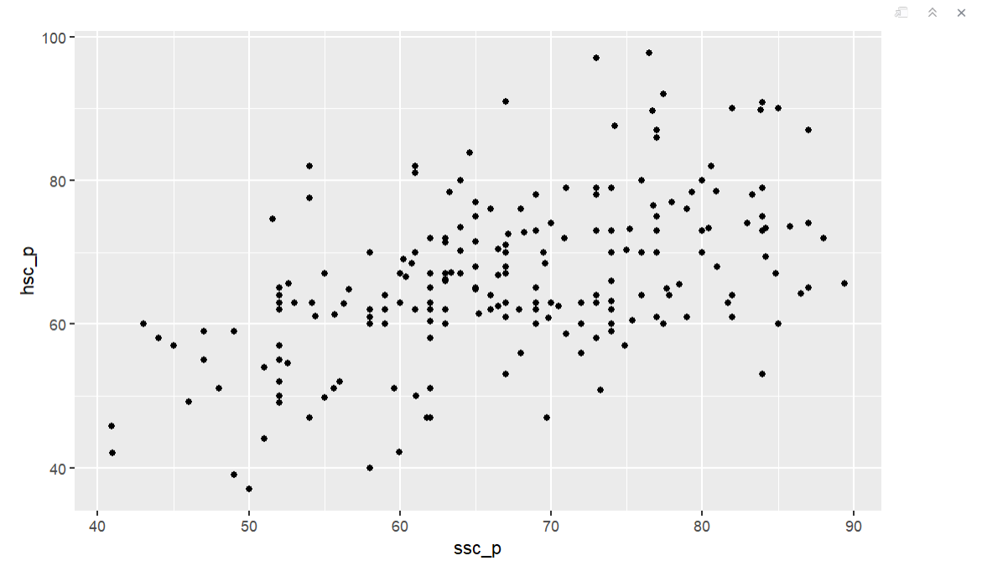
1. ORIGINAL REPRESENTATION

Slide 6
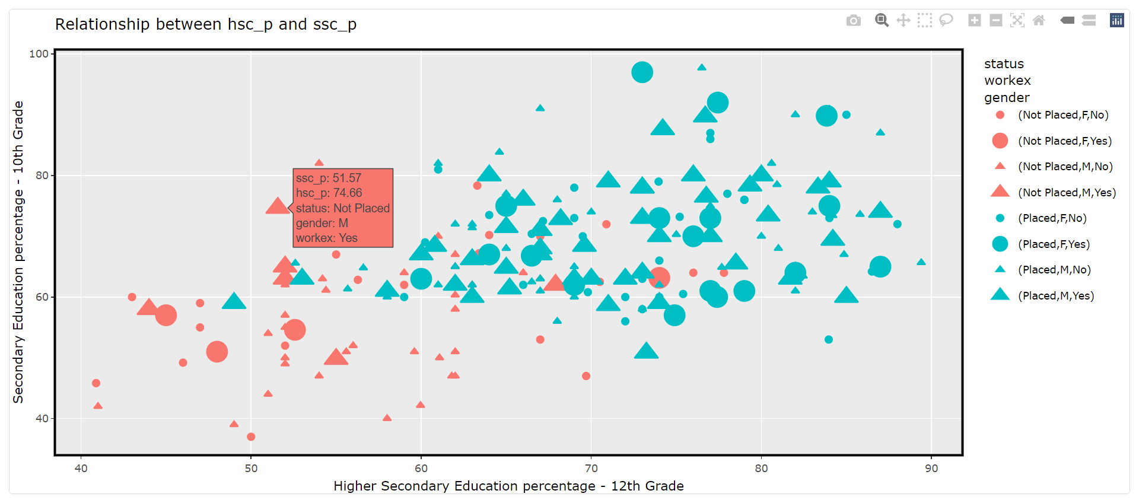
1. REDESIGNED REPRESENTATION

Slide 7
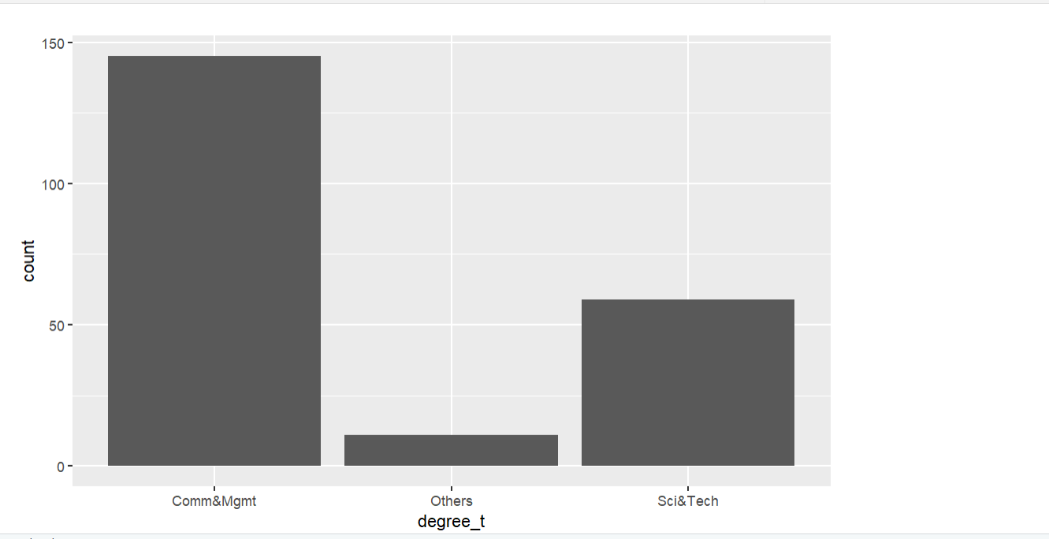
2. ORIGINAL REPRESENTATION

Slide 8
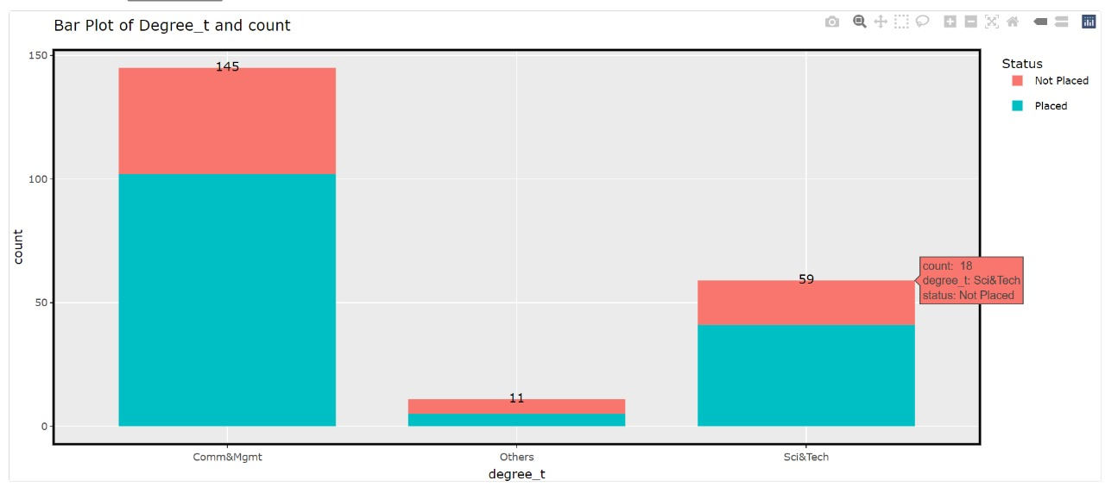
2. REDESIGNED REPRESENTATION

Slide 9
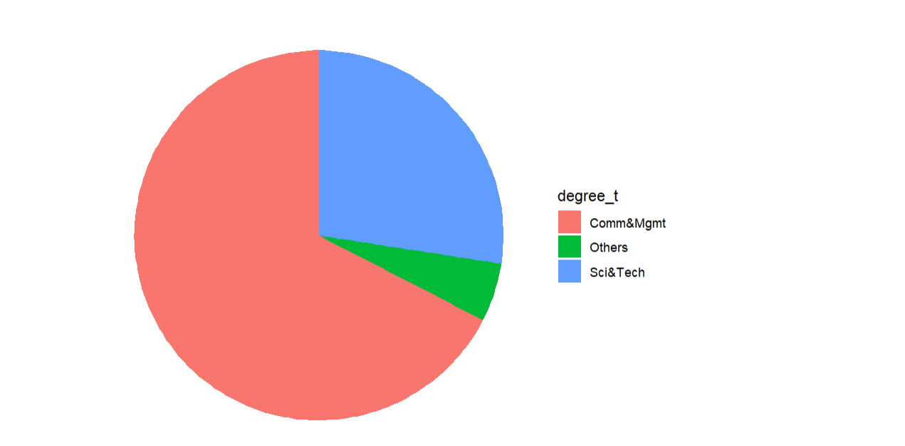
3. ORIGINAL REPRESENTATION

Slide 10
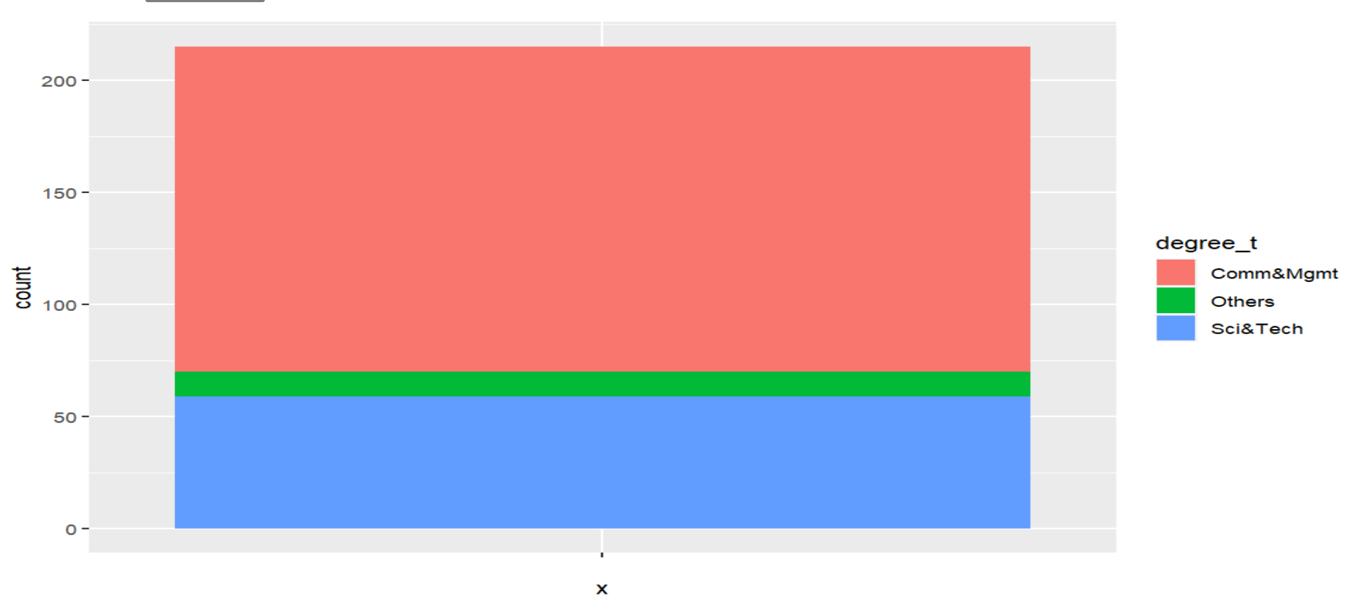
3. REDESIGNED REPRESENTATION - 1

Slide 11
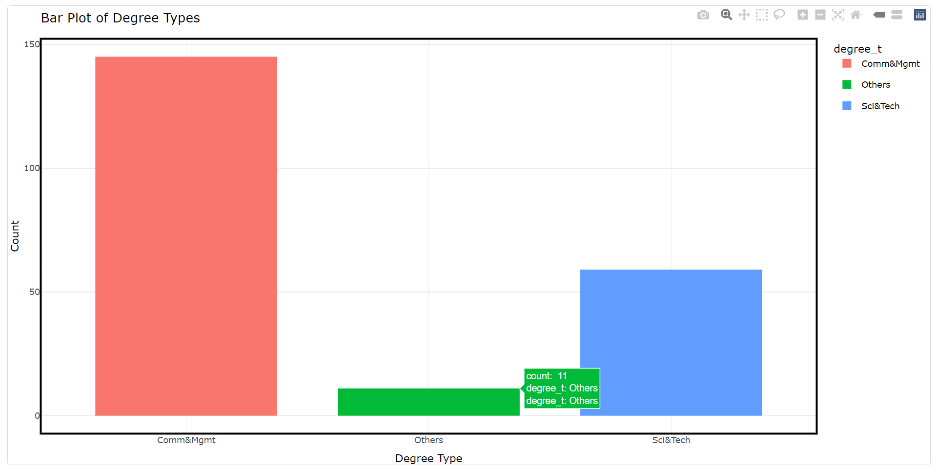
3. REDESIGNED REPRESENTATION - 2

Slide 12
DATASET OF SLEEP HEALTH AND LIFESTYLE DATA

Slide 13
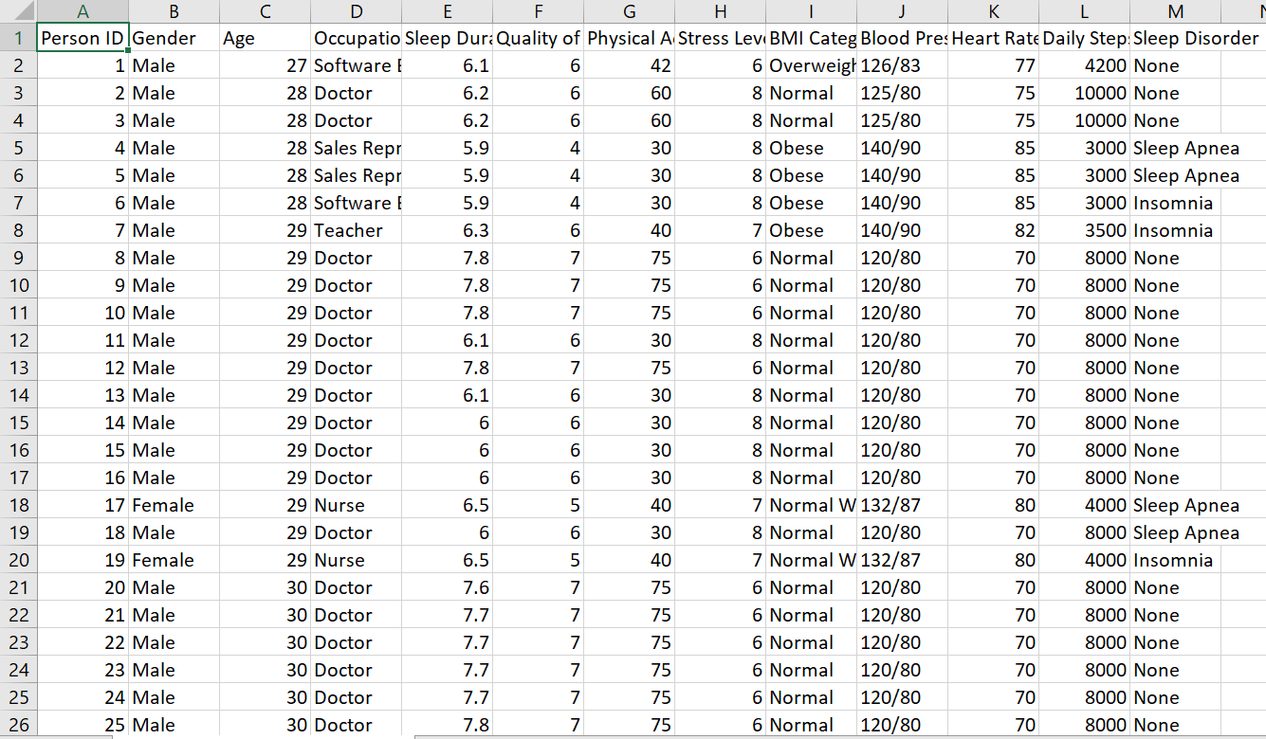
SLEEP HEALTH AND LIFESTYLE DATA DATASET OF THE ORIGINAL GRAPH

Slide 14
ORIGINAL AND REDESIGNED REPRESENTATIONS

Slide 15
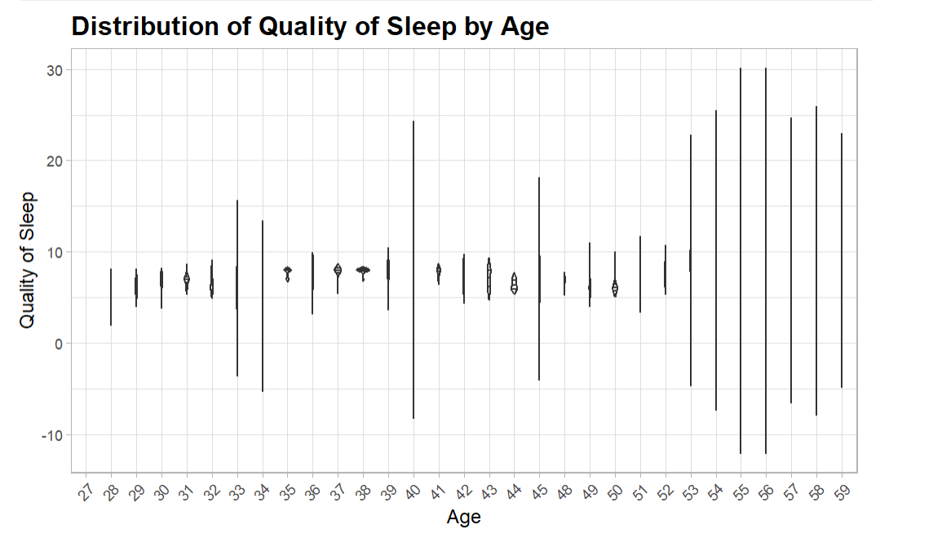
4. ORIGINAL REPRESENTATION

Slide 16
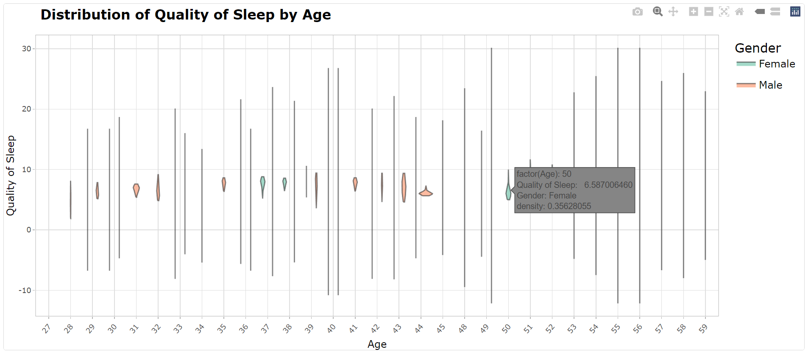
4. REDESIGNED REPRESENTATION- 1

Slide 17
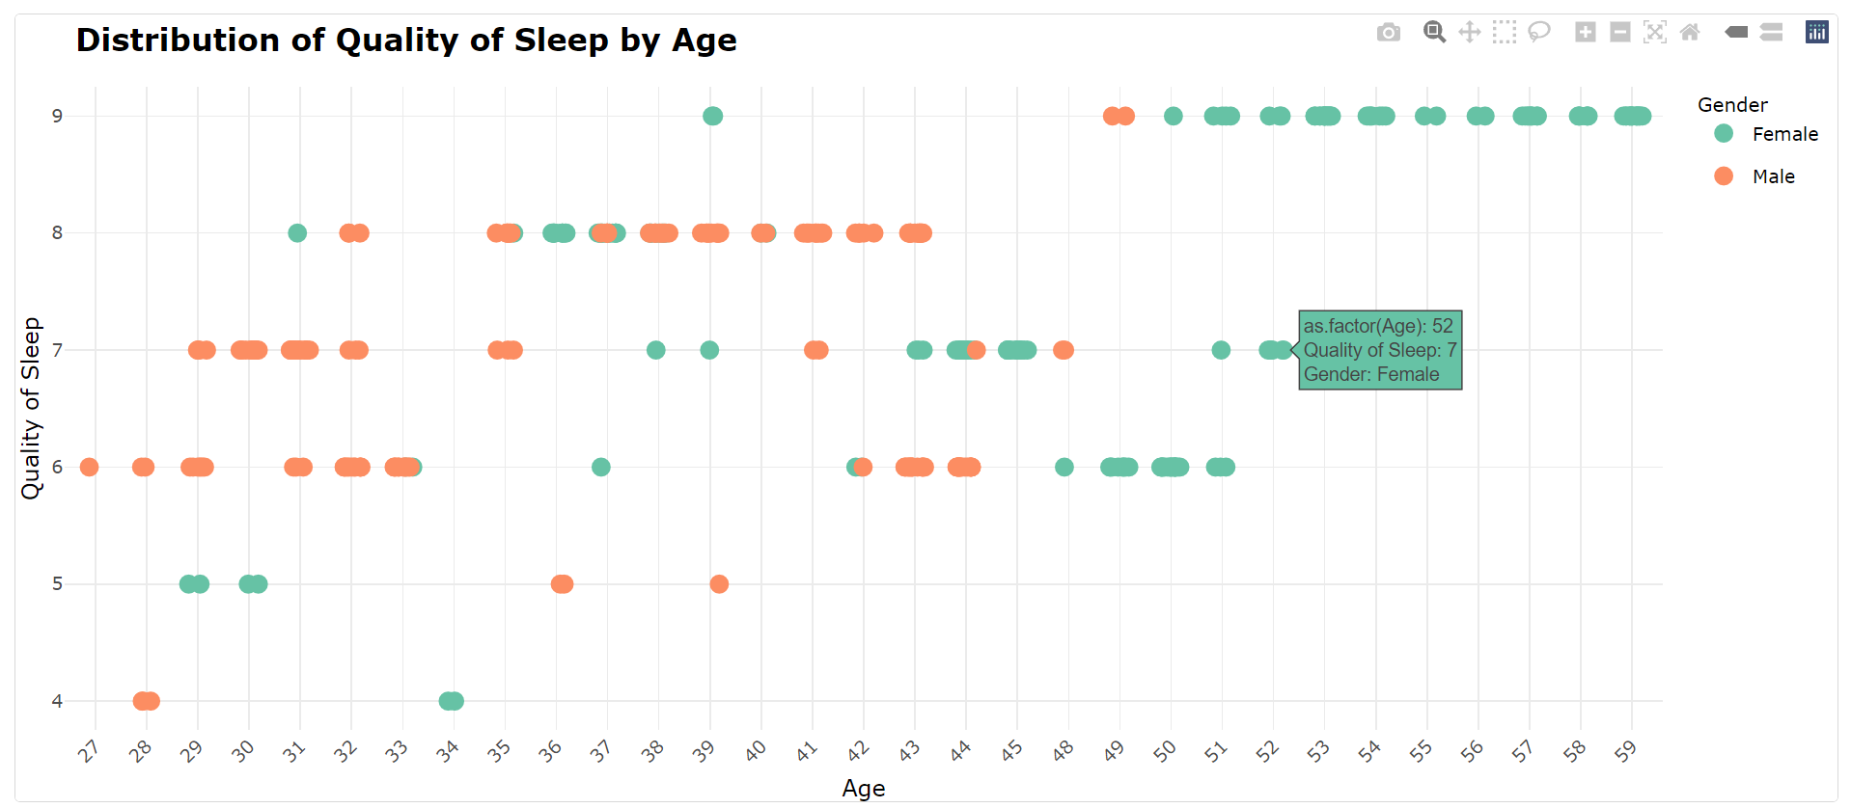
4. REDESIGNED REPRESENTATION- 2

Slide 18
THANK YOU

